Slide 1


SOMERSET PURPOSE
Somerset Academy, Inc. promotes a transformational culture that maximizes student achievement and the development of accountable, global learners in a safe and enriching environment that fosters high-quality education.
S - Set high expectations
O - Objective
M - Meaningful curriculum
E - Effective
R - Resourceful and responsible life long learners
S - Scholars who achieve proficiency and beyond
E - Evaluate continuously and use data to drive curriculum
T - Teachers who are highly qualified

Slide 2
DO NOT. . .
“Hang out” in the stairwells or on the second floor during lunch.
Chew gum. DO NOT BRING GUM!
Go on the basketball court with a skateboard!
Use the elevator without approval from the office.
Leave campus if you are a Middle Schooler, Freshman or Sophomore (Except for DE students)
Allow an underclassmen in your vehicle without prior permission, or you will lose all privileges for the remainder of the school year.
Throw anything off the balcony.
Throw anything from the ground level to the 2nd floor.
Eat or carry food over the basketball court or turf field
Litter or leave garbage around at lunch
Hang out by the wavy wall side or behind the basketball court bleachers
Hang on or grab the basketball nets/rims
Playing “keep away” = a detention
Yoga pants/ leggings/ are not allowed. Not even during dress down days. Dress code violations earn detentions
You are not to go to the Deans’ office during class to argue a detention. You will be turned away.

Slide 3
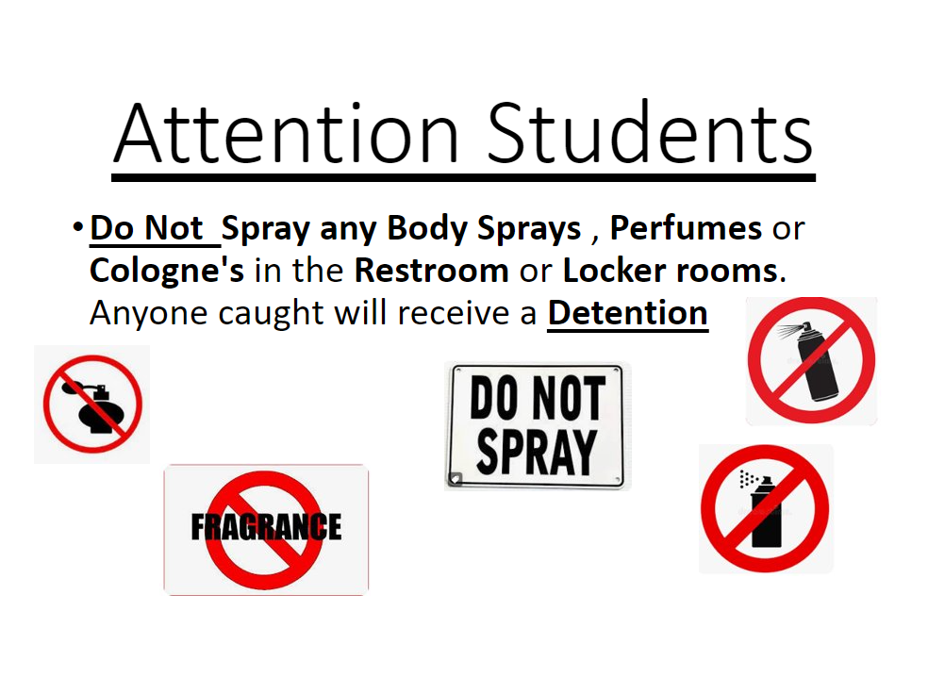

Slide 4
Dress Code (What can I wear)
School Appropriate Attire
OK
PE Shorts PE Shirts
Solid Color Shorts (Fingertip length or longer)
Denim, Khaki, Cargo & Jean Shorts
House Shirts
Club Shirts
Skorts, Capris Any color
Not OK
Spandex Material
Rips , Tears or Frays
Sweatpants, Yoga pants
Tank tops
Leggings
Bottoms with print or derogatory slogans

Slide 5
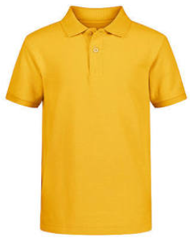
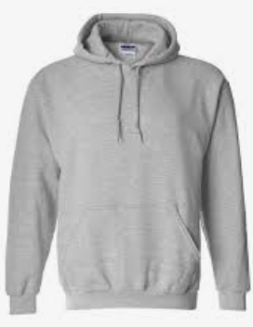
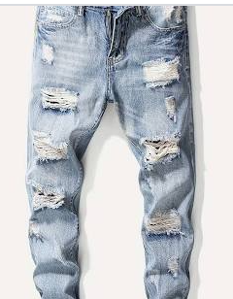
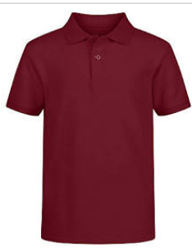
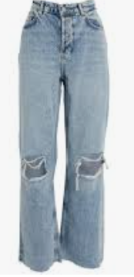
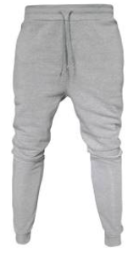
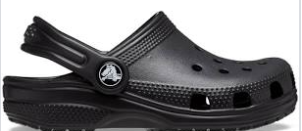
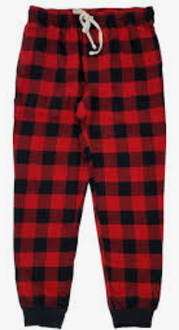
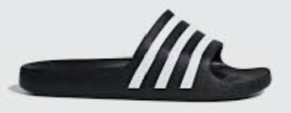
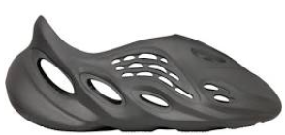
Dress Code Violations (Do Not Wear)
Ripped or Frayed Jeans
Non - Somerset, Hoodies or Polos
Crocs, Slides & Foam Runners
Sweatpants, Joggers, Yoga pants, tights or Pajama pants

Slide 6
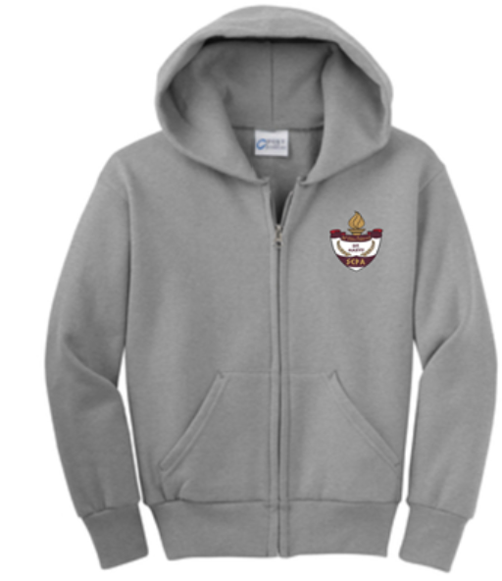
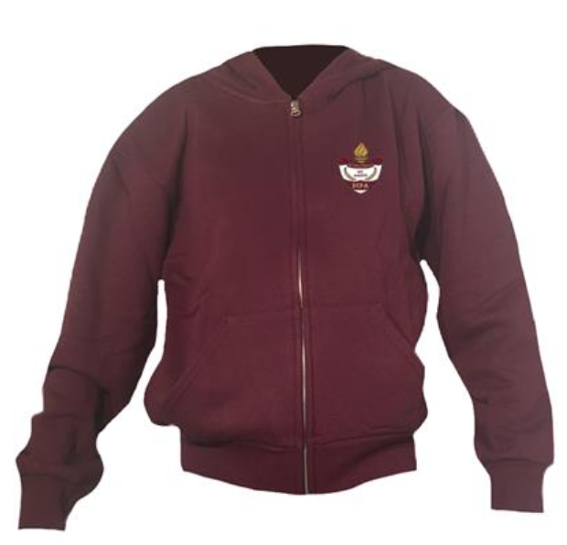
Dress Code Violations
A Somerset College Prep Shirt must be worn underneath a zip up Hoodie or Jacket.
Shirts include
House Shirts
School Friday Shirts
Club Shirts
School Athletic apparel for game days.
Anyone not in compliance will be given a Dress Code Violation according to our Discipline Matrix.

Slide 7
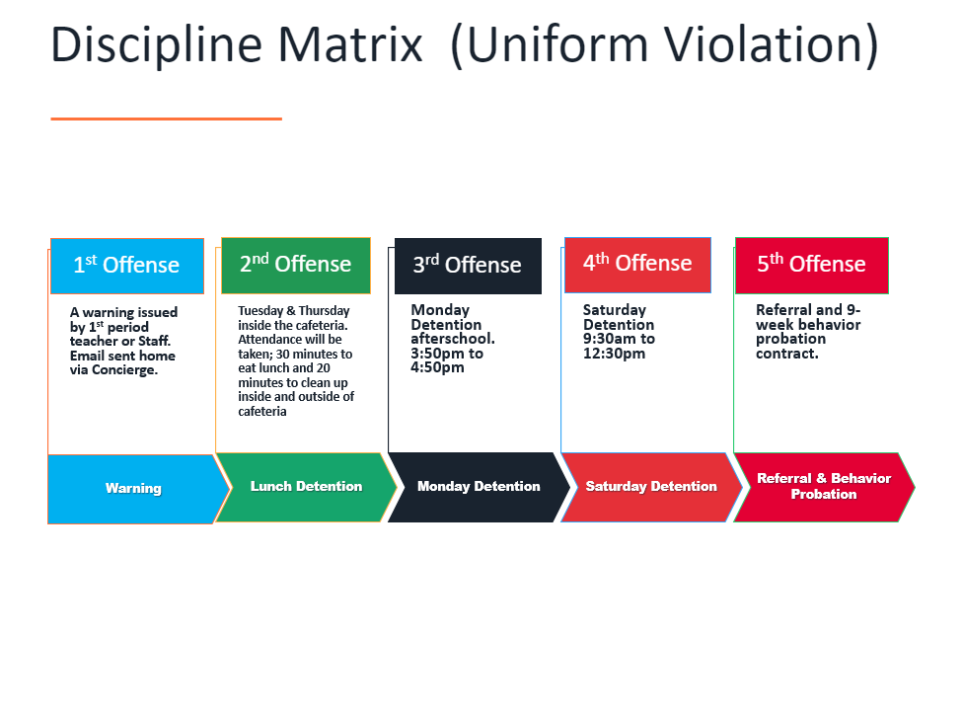

Slide 8
Somerset College Prep Discipline Matrix
*Warnings* Do Not apply to all discipline. Teacher & Staff discretion
DETENTION
SATURDAY DETENTION
SUSPENSION through DISMISSAL
3:50 to 4:50pm
Classroom Disruption
Disruptive Conduct
Chewing Gum
Bus Violation
Disrespect for others
Disrespect for property
Littering during lunch
Electronic Confiscation
Public Display of Affection / P.D.A
Profane Obscene Abusive Language
Running in the Halls
Spray used in the Restrooms
Tardy to Class
Tardy to School ( 3 late arrivals non bus rider)
9:30 to 12:30pm
Horseplay
Missed Detention
Multiple Detentions
Disruptive Conduct
Bus Violation
Skipping = 2 Saturday Detentions, Referral & 9 week Behavior Probation Contract
Cheating = 3 Saturday Detentions, Referral & Behavior Probation Contract
Excessive Detentions / Unserved Detention
Theft
False or Misleading Info
Open Defiance of Authority
Vaping
Physical Altercation
Fighting or Attempting to Fight
Assault / Intimidation Threat of Student
Weapons
Other Major Misconduct

Slide 9
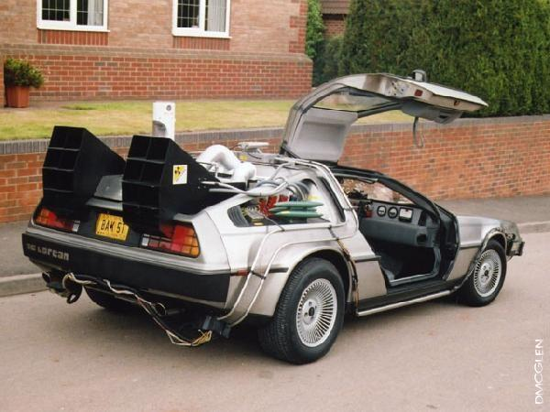
Tardy—being late to class.
Being tardy to periods 2, 3, or 4 is accompanied by a detention.
Period 2, 3, 4 teachers write & submit the detention.
Being tardy to 1st period is a detention if you are a bus rider and your bus was on time.
Being tardy to 1st period and you are not a bus rider is a detention for every 3rd occurrence.
*Does not apply to excused tardies.

Slide 10




TURF DURING LUNCH
Volleyball
Monday-Friday: NO SPIKING!!!
Basketball
Monday / Wednesday: Highschool only
Tuesday / Thursday: Middle School only
Rotate Fridays
( Highschool has the 1st Friday of each Month)

Slide 11



No Sports on Turf Afterschool without a Coach

Slide 12

Cafeteria
Breakfast service ends at 8:20 AM
Lunch service ends at 12:20 PM

Slide 13
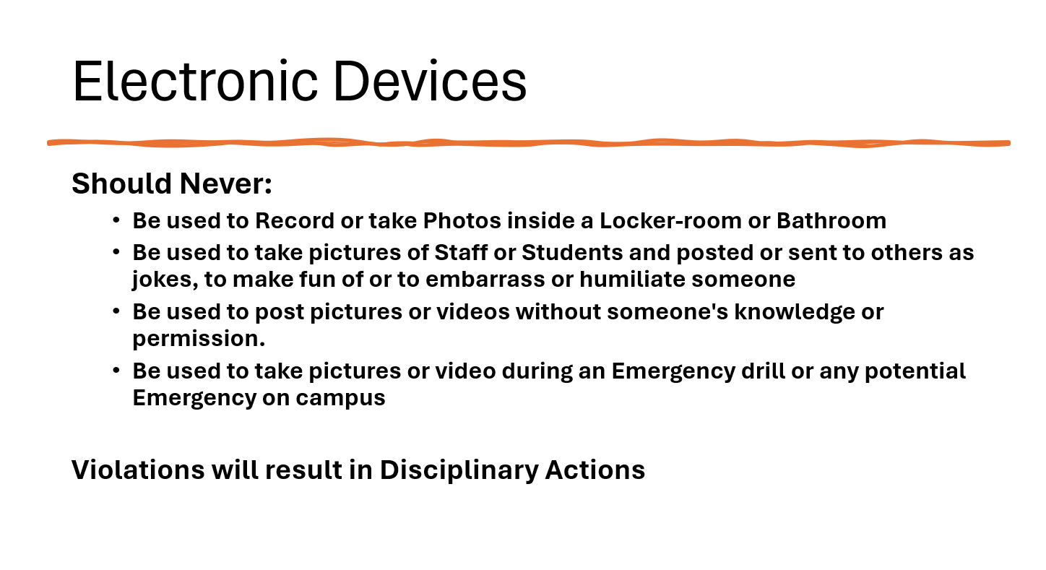

Slide 14
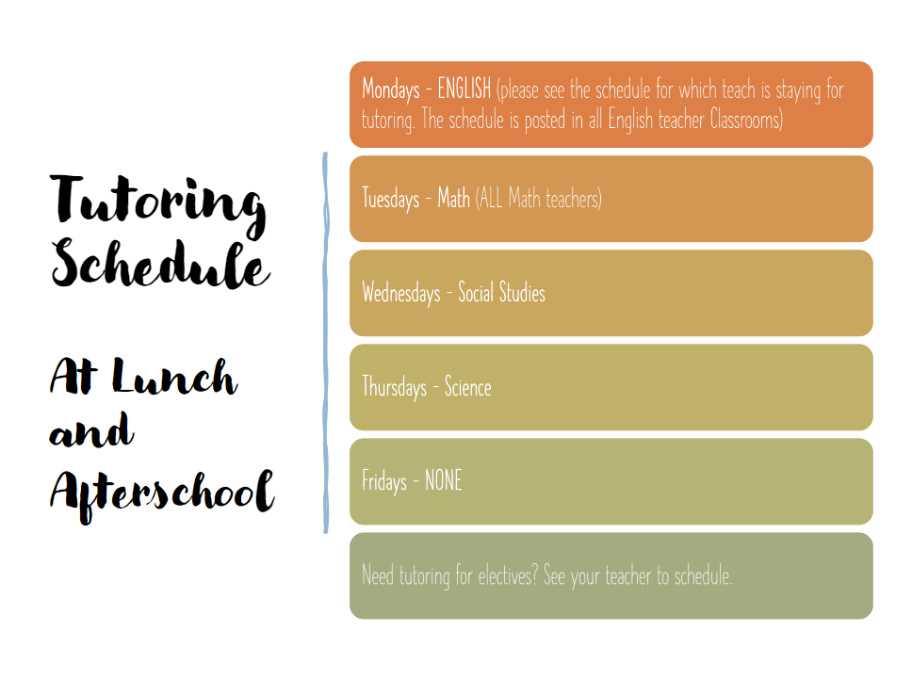

Slide 15

Lost & Found
Lost & Found items located in the breezeway by the cafeteria will be discarded every other Friday.
All non school clothing items including water bottles lunch boxes, books will be thrown out. April 5th
April 19th May 3rd
May 24th

Slide 16
SAT School Day
March 27th = Seniors
March 28th = Juniors
Check your school email for more info

Slide 17
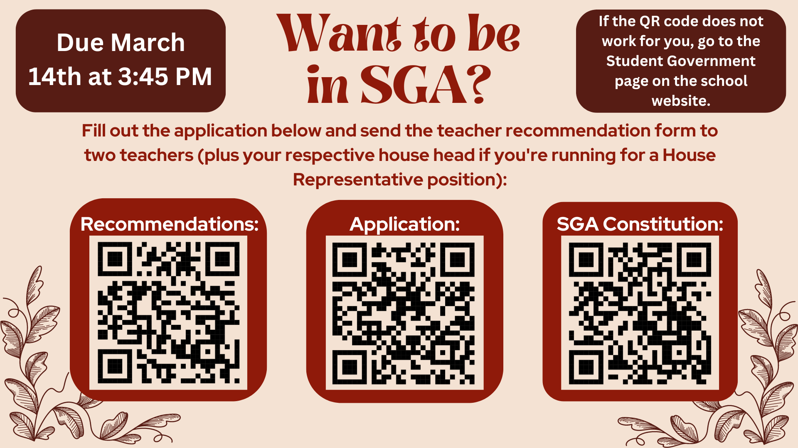

Slide 18
2024 Career Fair
May 8th, 2024, Wednesday
9:30 AM – 12:30 Pm
Who: Class of 2024 and 2025
Location: Somerset College Prep Gym
Dress Code: Business casual
Please check your e-mail for interest form and more information to come.
On the spot interviews bring your resumes

Slide 19
BEST Writing Test April 4th – 8th
Dates for Testing | Grades Testing
Wednesday 4/3 | 10th & 9th
Thursday 4/4 | 9th & 8th
Friday 4/5 | 8th & 7th
Monday 4/8 | 6th
Look for emailed announcements regarding testing rooms and dates the week before the writing test

Slide 20




8th grade only
Tickets on Sale During Lunch in Cafeteria
SEE Mr. Horne
Permission Slips in Front Office
Last Day to Purchase March 14th

Slide 21


Slide 22
ESE Tutoring
Starting March 4th, Ms Reeves and Ms Jimenez will have ESE tutoring Mondays from 4:00-5:00
Tutoring will be after school in room 124 for math and ELA

Slide 23
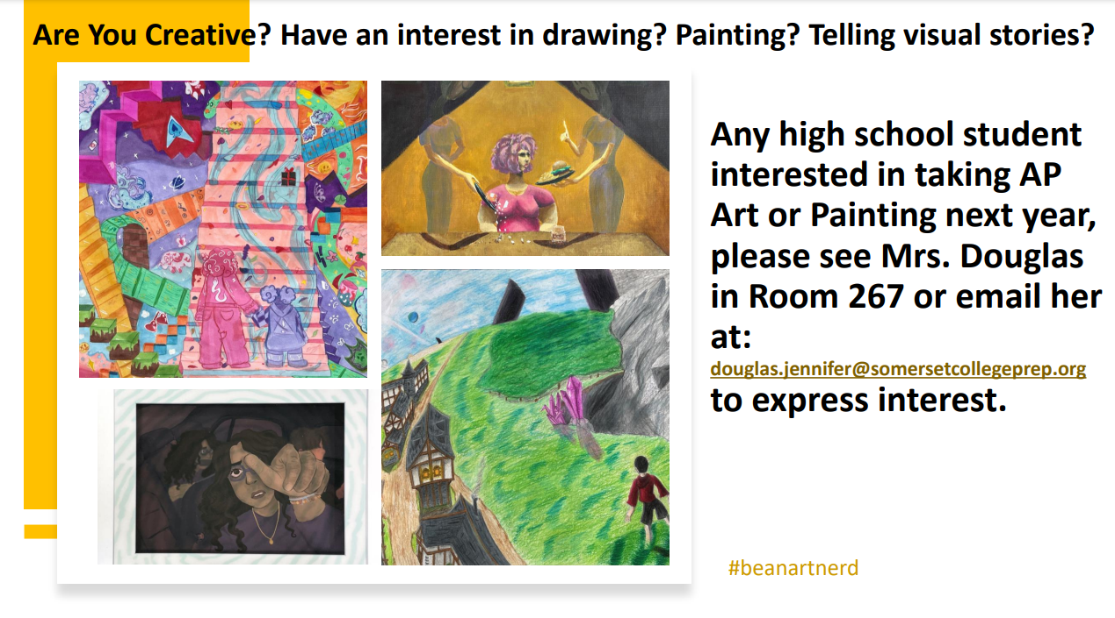

Slide 24





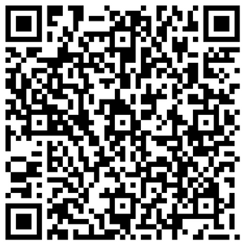


File
Edit
View
Session 01
Session 02
NEED HELP WITH CLASSES?
Scan the QR code and SGA will match you with a peer tutor that will best suit your needs!

Slide 25


Slide 26
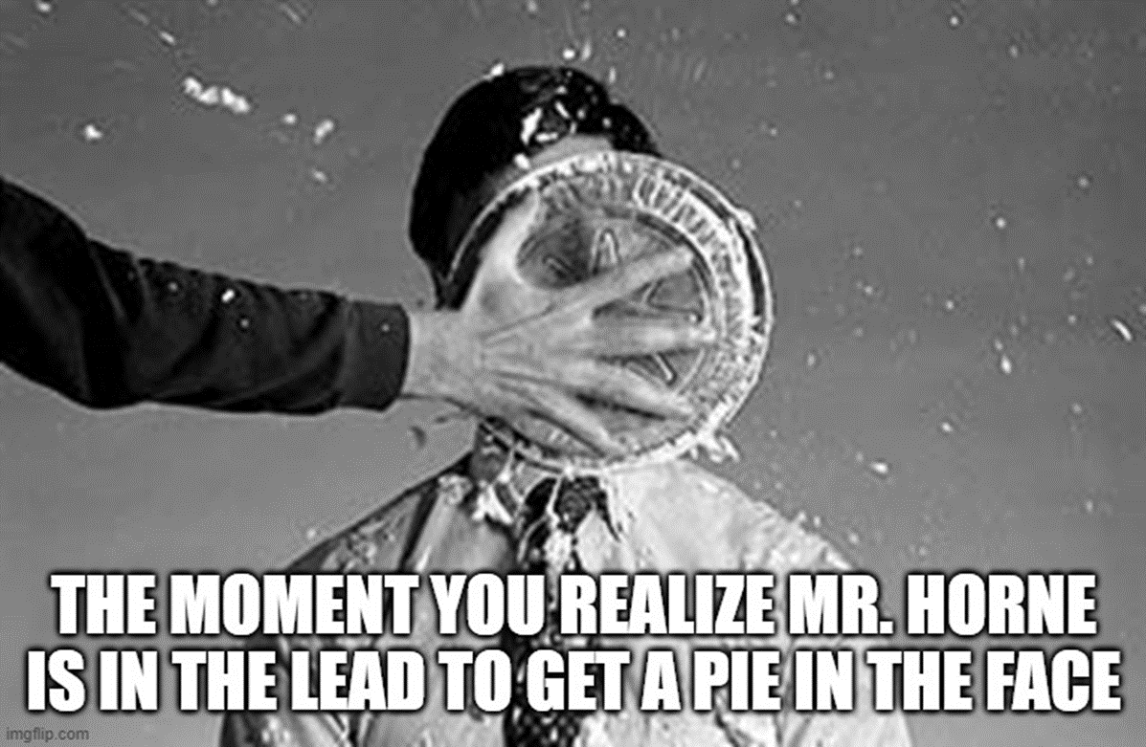
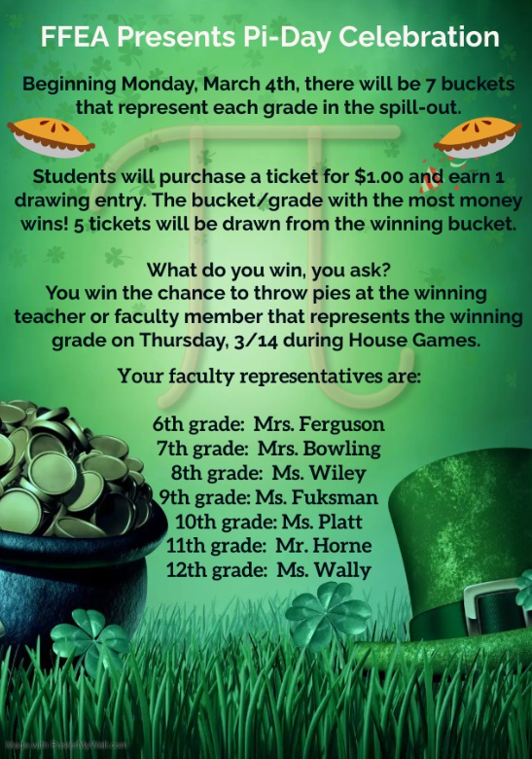
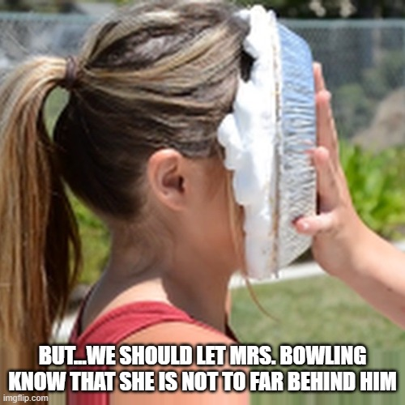

Slide 27


Slide 28


Somerset College Prep &Public Wireless ACP Program
This document will also be in the front office for you to scan the QR code.

Slide 29
Attention High School Students
Test | Registration Deadline | Actual Test Date
SAT | Feb 23 | March 9
ACT | Jan 5 | Feb 10
ACT | March 8 | April 13
ACT | May 3 | June 8
SAT | May 16 | May 21
SAT | Apr 19 | May 4
You can register online to take these tests at various locations. See your guidance counselor for help registering or to see if you qualify for a fee reduction. School Day SAT will be on campus and free for 11th and 12th graders in March.

Slide 30

Interested in starting a school club?
If you’re interested in starting a school club, you should do the following:
  Find a teacher to sponsor the club. Give them the details about the club so they know if they’re able to sponsor the club.
  Create a petition and get students who would be interested in your club to sign it. This shows that your club has generated interest.
  Talk to someone in administration about getting your club approved. Tell them who the sponsor is, when the club will occur (lunch or afterschool), and what the club entails.
  Email Mr. Kyryliw (Kyryliw.Michael@somersetcollegeprep.org) the information about you club and a slide advertising it. I will leave the advertising slide up for a week or so and create a slide listing all the club information for easy reference.

Slide 31
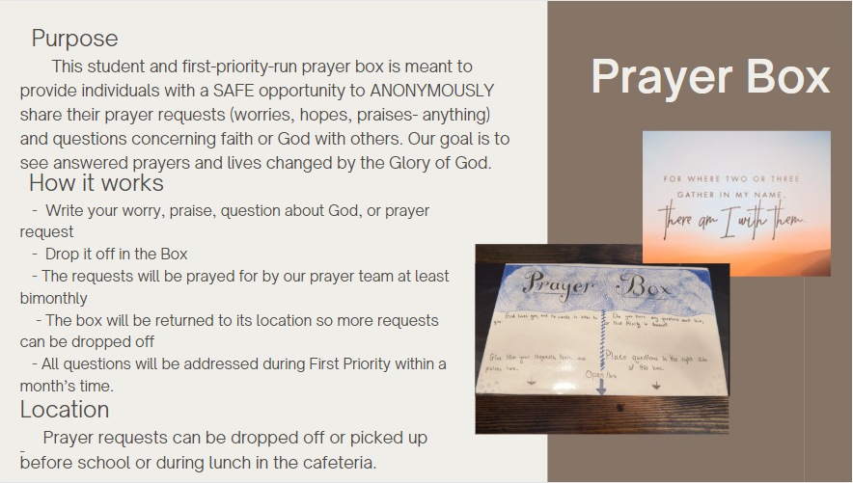

Slide 32
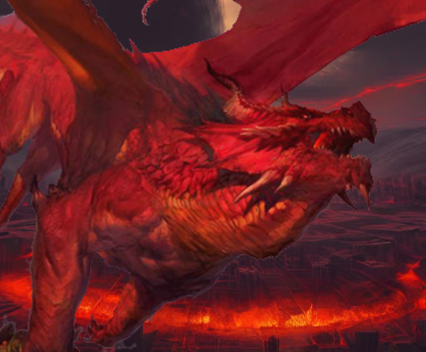

!Attention!
Dungeons and Dragons Club INFO!
READY FOR ADVENTURE, THRILLS, AND FANTASY?
COME TO THE D&D CLUB MEETINGS
MONDAYS AT 3:50 TO 5:15 PM
IN ROOM 175

Slide 33
Club Schedule
D & D- Mondays after school, 4-5:15
Yearbook- Mondays at lunch in 228
Chorus- Monday, High School 4-5:30 and Middle School, Thursdays, 4-5:30
Battle of the Books- Tuesdays, at lunch, in 227
FFEA- Tuesdays, at lunch, in 123A
S.A.D.D- Tuesdays, at lunch, in 173
Sonic Club- Tuesday at lunch, in room 170
Salsa Dance- Tuesdays and Thursdays at lunch in 136
Weightlifting Club- Tuesdays and Thursdays, afterschool, at 4-5:15 in the weightlifting room.
Community Service Club- Wednesdays at lunch, in 232
Sign Language- Wednesdays, at lunch, in 265
Boxing Club- Wednesdays, after school, on the turf
GSA- Wednesdays at lunch in 169
First Priority- Wednesdays, in room 263 at lunch
Artists for a Cause Club- Thursdays (at lunch) and the 2nd Wednesday of each month (after school), in room 268.
Chess Club- Thursday, at lunch, in 230
Literature Club- Thursday, at lunch, in 276
Drama Club- Thursdays, after school, in 168
Science Olympiad- Fridays at lunch in 247
Music Club- Fridays at lunch in 241
Guitar Club- Fridays, afterschool, in 169

Slide 34





House Reminds
For anyone who needs the house remind this year ☺ This is important for communication with your house head.
  Ares-@houseare
  Athena-@scpaathena
  Hestia- @househes
  Poseidon- @psdnscpa
  Zeus-@housezeus

